Slide 1
Data Mining (CS 451)
JAN-MAY’ 18
PRAGYA VERMA

Slide 2
RECAP
Data Integration
Correlation Test for Nominal Data
Practice Question

Slide 3
CONTENT
Data Integration
Correlation coefficient for Numeric Data
Covariance of Numeric Data
Practice Questions

Slide 4

Correlation Coefficient for Numeric Data
We can evaluate the correlation between attributes A and B by computing the correlation coefficient (also known as Pearson’s Product Moment Coefficient).
Correlation coefficient can be computed as follows:
If r_{A,B} > 0 it implies that A, B are positively correlated; r_{A,B} = 0 implies A, B are independent and r_{A,B} < 0 implies that A, B are negatively correlated.

Slide 5



Covariance of Numeric Data
Let A and B be two numeric attributes with a set of n observations {(a₁, b₁), (a₂, b₂), … ,(a_{n}, b_{n})}.
The mean values of A and B, respectively are also known as the expected values on A and B, that is,
The covariance between A and B is defined as,

Slide 6

Covariance of Numeric Data
r_{A,B} is related to covariance of A and B as follows:
It can also be shown that,
If A and B are independent then Cov(A, B) = 0. However, the converse is not true.

Slide 7
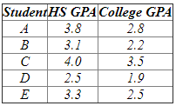
Practice Question 1
Suppose that 5 students were asked their high school GPA and their College GPA, with the answers as follows:
Is high school and college GPA related according to this data? If they are related, how can I use the high school GPA to predict the college GPA?

Slide 8
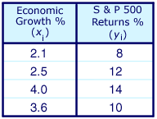
Practice Question 2
Consider the table below, which describes the rate of economic growth (x_{i}) and the rate of return on the S&P 500 (y_{i}).
Using the covariance formula, determine whether economic growth and S&P 500 returns have a positive or inverse relationship.

Slide 9
Next Class
Data Transformation

